Slide 1
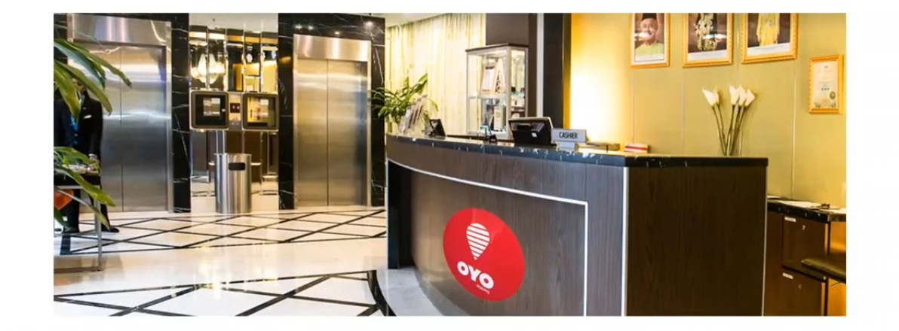

Sql Case Study
OYO Business Room Sales Analysis
Presented by Pooja Pawar
Solutions are Coded in - Microsoft Sql Server

Slide 2


Introduction
There are 2 datasets. The First dataset contains information on Hotel booking details by various customers in different cities. The following attributes on the datasets are as follows:
Booking Id: Id by which a particular booking has been made.
Customer Id: Id by which the customer made a booking, here customer had made a booking multiple times.
status: shown the status of booking
check_in: Date when the user checks-in into the hotel check_out: Date when the user checksout from the hotel no_of_rooms: Total Rooms booked by each booking

Slide 3
Introduction
hotel_id: It is the hotel_id in which we had booked the Room amount: Amount paid by the customer.
Discount: Discount is given while booking
date_of_booking: it is the date when the booking has been created, Here we have the booking data for 1st quarter of year 2022.
The Second dataset contains information on Hotel_id and city where it is located.
Tables & Charts are developed in - Microsoft Excel

Slide 4

OBJECTIVES
Analyse the bookings for the given time period Derived the insights based on Analysis.
Some Business Questions
Average rates of different cities
No of hotels in different cities
Cancellation rate
No. of Bookings in a given
Discount offered
No. of nights stayed by customers
How many days prior bookings are made
Revenue

Slide 5


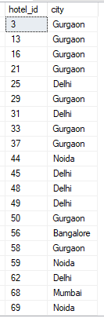
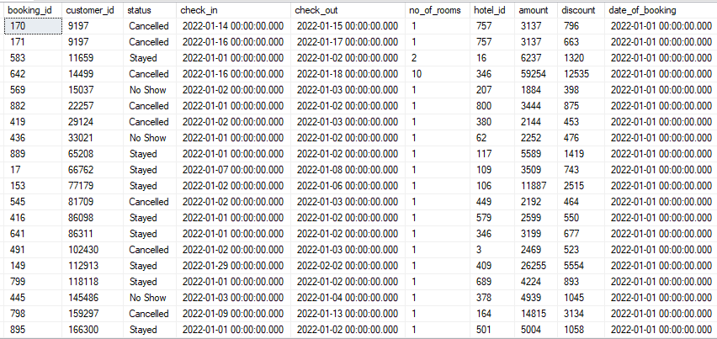










Datasets
City Table:
Hotel_Sales Table:
2889 records
357 records

Slide 6
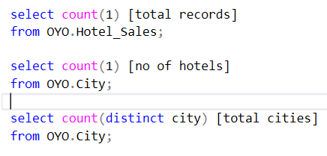
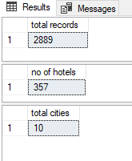



Start with some basic EDA - total records , No of Hotels & Total Cities etc.

Slide 7
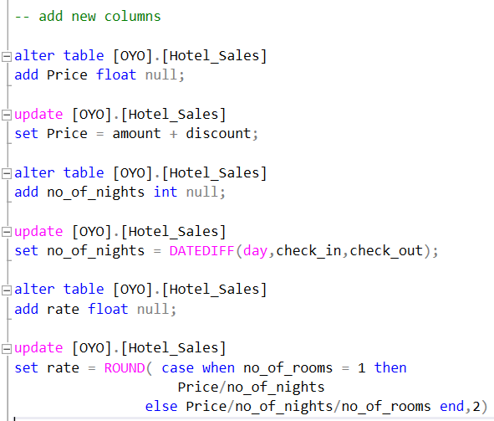
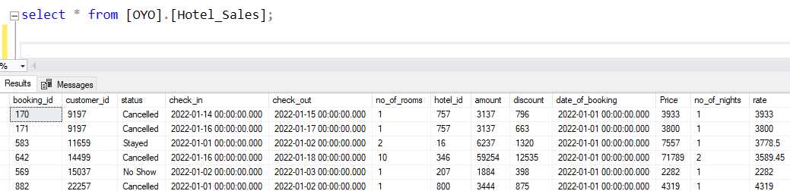

Add New Columns to the tables and derived all the details from Hotel_Sales tables as you can see below.......

Slide 8
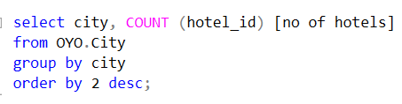
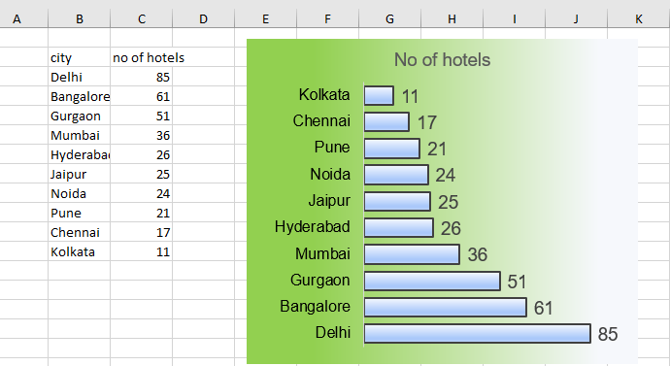

-- No of hotels in different cities

Slide 9

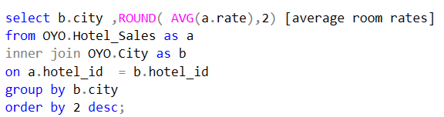
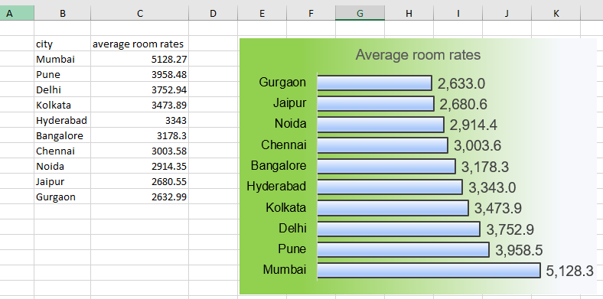










-- average room rates of different cities

Slide 10
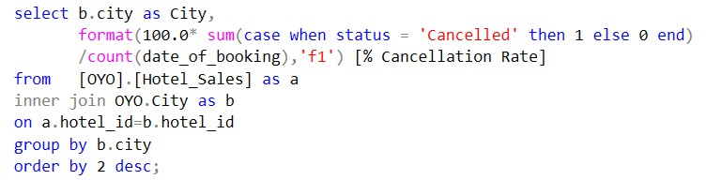
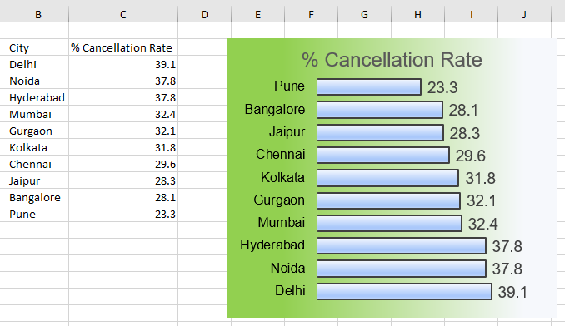

-- Cancellation rates of different cities

Slide 11
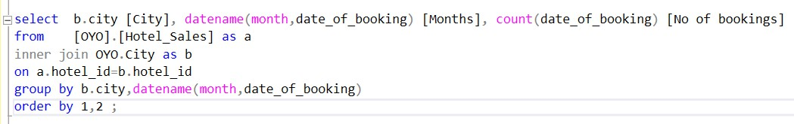
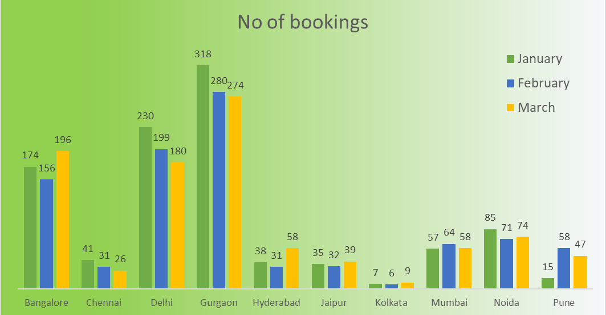
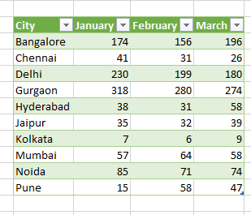
-- No of bookings of different cities in Jan Feb Mar Months.
I USED POWER QUERY HERE

Slide 12
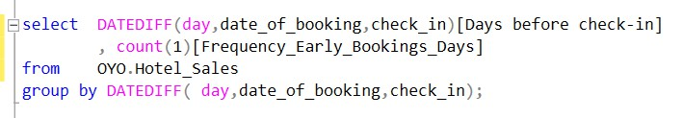
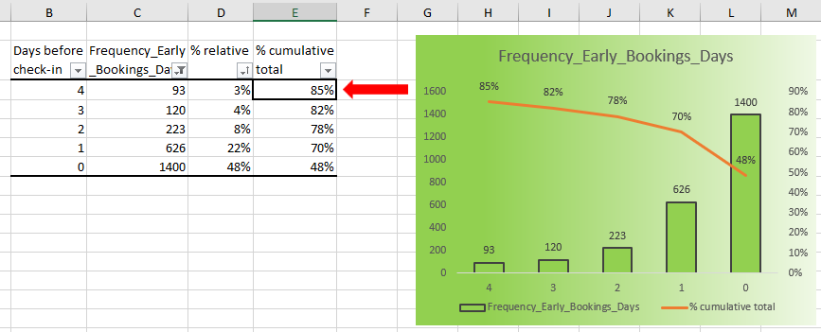

-- Frequency of early bookings prior to check-in the hotel

Slide 13
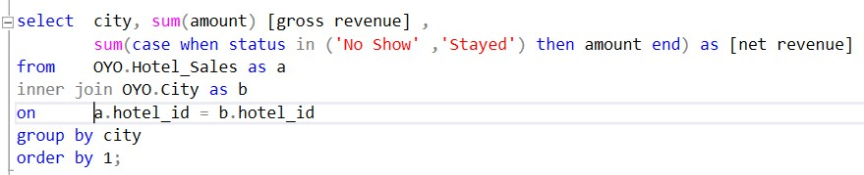
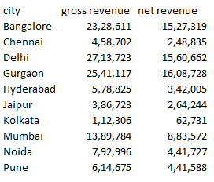
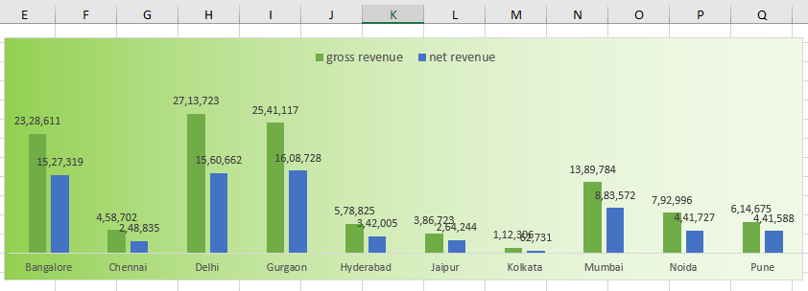
-- Net revenue & Gross revenue to company

Slide 14
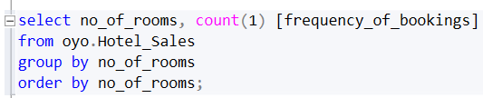
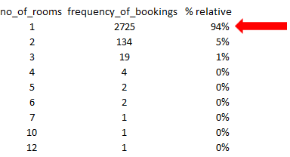


-- Frequency of bookings of no of rooms in Hotel

Slide 15
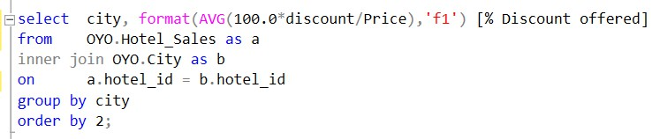



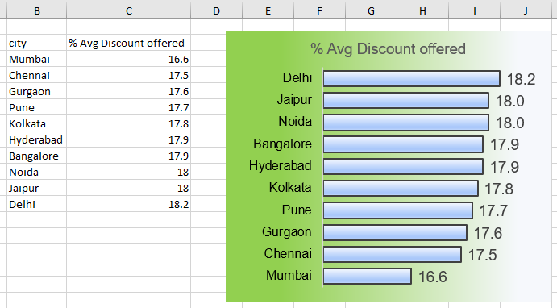







-- Discount offered by different cities

Slide 16


Insights
1. Banglore, Gurgaon & Delhi were popular in the bookings, whereas Kolkata is less popular in bookings 2. Banglore, Gurgaon & Delhi have more hotels, whereas Kolkata, Pune & Jaipur have fewer hotels.
Mumbai was the costliest city and Gurgaon was the cheapest city in terms of Average room rates.
Nature of Bookings:
Nearly 50 % of the bookings were made only on the day of check-in.
Nearly 85 % of the bookings were made with less than 4 days prior to the date of check-in.
Very few no.of bookings were made in advance(i.e over a 1 month or 2 months).
Nearly 94% of the bookings involved only a single room.
Nearly 80% of the bookings involved a stay of 1 night only.
Gurgaon was highest and Kolkata was lowest in terms of Net Revenue.
Oyo should acquire more hotels in the cities of Pune, Kolkata & Mumbai. Because their average room rates are comparatively higher so more revenue will come.
The % cancellation Rate is high in all 9 cities except Pune, so Oyo should focus on finding reasons about cancellation.
The discounts offered in all cities were nearly 16 to 18%. More discounts should offer to those cities where more no of hotels like Banglore ,Gurgaon & Delhi.

Slide 17





